Slide 1
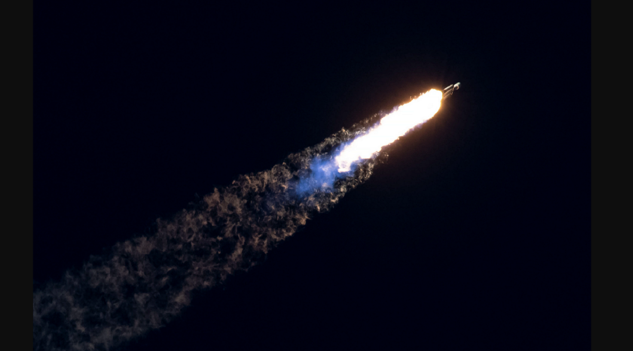

Data Science Capstone Project
Ilya Elper
21.05.2023

Slide 2
Outline
Executive Summary
Introduction
Methodology
Results
Conclusion
Appendix

Slide 3
Executive Summary
Summary of methodologies
Collecting Data Using API
Collecting Data Using Web Scraping
Data Wrangling
EDA with SQL
EDA with Visualization
Interactive Visual Analytics with Folium
Predictive Analysis
Summary of all results
Exploratory Data Analysis result
Interactive analytics in screenshots
Predictive Analytics result

Slide 4
Introduction
Project background and context
We will predict if the Falcon 9 first stage will land successfully. SpaceX advertises Falcon 9 rocket launches on its website, with a cost of 62 million dollars; other providers cost upward of 165 million dollars each, much of the savings is because SpaceX can reuse the first stage. Therefore if we can determine if the first stage will land, we can determine the cost of a launch. This information can be used if an alternate company wants to bid against SpaceX for a rocket launch.
Problems you want to find answers
What factors determine whether a rocket lands successfully?
Interaction between different features that determine the likelihood of success of a successful landing.
What operating conditions must be created to ensure a successful planting program.

Slide 5



Methodology

Slide 6
Methodology
Executive Summary
Data collection methodology:
Data from SpaceX was obtained from 2 sources:
Using SpaceX Rest API
Using Web Scrapping from Wikipedia
Perform data wrangling
Filtering the data
Dealing with missing values
Using One Hot Encoding to prepare the data to binary classification
Perform exploratory data analysis (EDA) using visualization and SQL
Perform interactive visual analytics using Folium and Plotly Dash
Perform predictive analysis using classification models
Building, tuning and avaluation of classification models to ensure the best results

Slide 7
Data Collection
The data collection process involved a combination of API requests from SpaceX REST and a table in the SpaceX Wikipedia article.
We had to use both data collection methods in order to obtain complete information about the launches for a more detailed analysis.
Link to SpaseX API
Link to Wikipedia

Slide 8
Data Collection – SpaceX API
Requesting rocket launch data from SpaceX API
bringing data to Data frame
Filtering the data frame to only include Falcon 9 launches
Deal with Missing Values
Exporting the data to CSV
Link to GitHub URL :Collecting the data SpaseX API

Slide 9
Requesting Falcon 9 launch data from Wikipedia
Creating a BeautifulSoup object from the HTML response
Constructing data we have obtained into a dictionary and further transformation to data frame
Extracting all column names and Collecting the data by parsing HTML tables
Exporting the data to CSV
Data Collection - Scraping
Link to GitHub URL :Web scraping from Wikipedia

Slide 10
Data Wrangling
Perform exploratory Data Analysis And determine Training Labels
Calculate the number of launches on each site
Calculate the number and occurrence of each orbit
Calculate the number and occurrence of mission outcome per orbit type
Exporting the data to CSV
Create a landing outcome label from Outcome column
Link to GitHub URL :Data wrangling

Slide 11
EDA with Data Visualization
In this EDA, three types of graphs were built:
Scatter plots - show the relationship between variables. If a relationship exists, they could be used in machine learning model.
Bar charts - show comparisons among discrete categories. The goal is to show the relationship between the specific categories being compared and a measured value.
Line charts - show trends in data over time (time series).
Link to GitHub URL : EDA with Data Visualization

Slide 12
EDA with SQL
Executed SQL queries:
Displaying the names of unique launch pads in a space mission
Display of 5 entries where starting pads begin with the string "CCA".
A display of the total payload mass carried by NASA Launched Launch Vehicles (CRS)
Display of the average payload mass of the launch vehicle version F9 v1.1
An indication of the date of the first successful landing on an unpaved area.
Listing of names of launch vehicles that are successful in unmanned vehicles and have a payload mass of more than 4000, but less than 6000
List of total number of successful and unsuccessful mission results
Listing of launch vehicle version names with maximum payload mass.
A list of unsuccessful landings on the drone ship, their booster versions and the names of the launch sites for the months in 2015
Ranking the number of landing results (eg "Failure" (unmanned craft) or "Success" (ground pad)) between date 06/04/2010 and 03/20/2017 in descending order
Link to GitHub URL : EDA with SQL

Slide 13
Build an Interactive Map with Folium
I have created an interactive map using the Folium library. The map includes markers for all launch sites based on their latitude and longitude coordinates. Each marker features a circular area, a popup label, and a text label to identify each launch site.
For the NASA Johnson Space Center, a separate marker with its coordinates is added, also displaying a circular area, popup label, and text label to indicate its location.
To show launch results at each site, I used colored markers. Successful launches are marked with green, while unsuccessful ones are marked with red. The markers are clustered to facilitate navigation and data analysis.
Additionally, I added colored lines to display the distances between a selected launch site (such as KSC LC-39A) and its surroundings, such as railways, highways, coastlines, and the nearest city.
This interactive map provides a visual representation of the geographical positions of the launch sites and their launch results, as well as demonstrates their proximity to various features and locations.
Link to GitHub URL : Interactive Visual Analytics with Folium

Slide 14
Build a Dashboard with Plotly Dash
Implemented a dropdown list for selecting launch sites. Pie Chart Showing Successful Launches (All Sites/Specific Site):
Included a pie chart displaying the total count of successful launches for all sites and the breakdown of success versus failures if a specific launch site is chosen. Slider for Payload Mass Range:
Integrated a slider to allow the selection of payload mass range. Scatter Chart of Payload Mass vs. Success Rate for Different Booster Versions:
Created a scatter chart to illustrate the relationship between payload mass and launch success rate across different booster versions.
Link to GitHub URL : SpaseX Dash App

Slide 15
Predictive Analysis (Classification)
Data
preparation
Creating a NumPy array from the columm “Class” in data
Modeling and validation
Performing cross-validation, each learning model.
Comparison of
results
Finding the method performs best by examining the Jaccard_Score , F1_score and Accuracy metrics
Standardization the data with StandardScaler
Splitting the data to train and test sets with train_test_split function
logistic regression
support vector machines (SVM)
decision trees
K-nearest neighbors (KNN)

Slide 16
Results
Exploratory data analysis findings:
• Space X operates from four different launch sites.
• Initial launches were conducted for Space X itself and NASA.
• The average payload of the F9 v1.1 booster is 2,928 kg.
• The first successful landing occurred in 2015, five years after the initial launch.
• Several Falcon 9 booster versions achieved successful landings on drone ships, particularly with payloads above the average.
• The mission success rate was nearly 100%.
• Two booster versions, F9 v1.1 B1012 and F9 v1.1 B1015, failed to land on drone ships in 2015.
• The number of successful landing outcomes improved over the years.

Slide 17
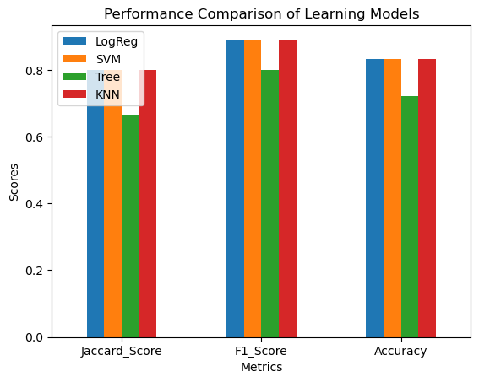
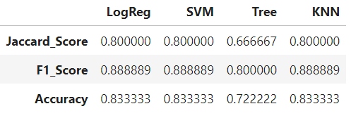
Results
By utilizing interactive analytics, it was possible to observe that launch sites are strategically located in safe areas, near the sea, and have well-developed logistic infrastructure in their vicinity. Furthermore, the majority of launches occur at launch sites situated on the east coast.
Based on the results of predictive analysis, it was determined that the decision tree classifier performed the poorest in predicting successful landings. On the other hand, the remaining models demonstrated comparable levels of accuracy in their predictions.

Slide 18

Inights drawn from EDA

Slide 19
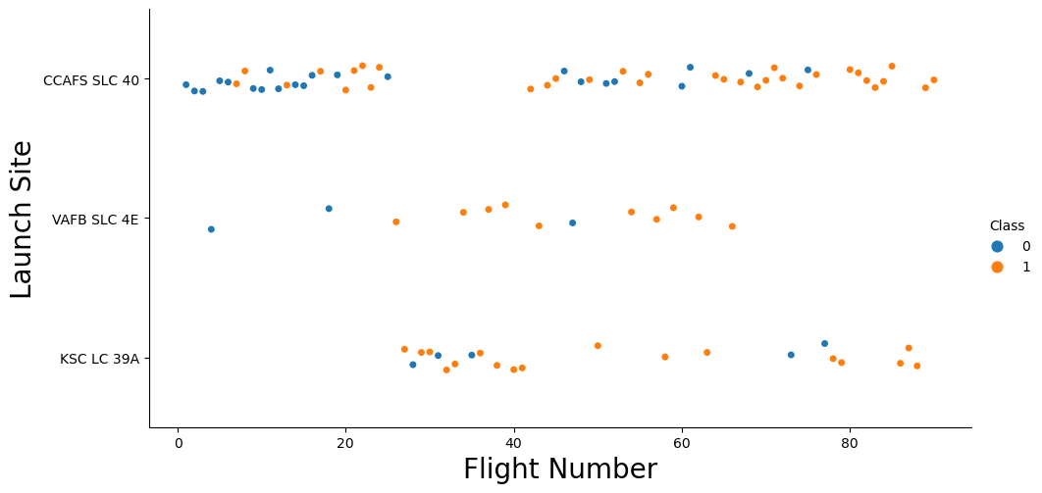
Flight Number vs. Launch Site
According to the plot, it is evident that the best launch site currently is CCAFS SLC 40, as it has witnessed a higher rate of successful launches, with a majority of recent launches achieving success. Following closely are VAFB SLC 4E and KSC LC 39A, which also have notable success rates. Additionally, the plot demonstrates an overall improvement in the success rate of launches over time.

Slide 20
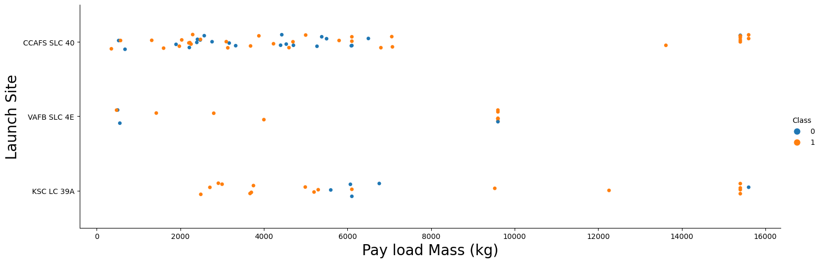
Payload vs. Launch Site
CCAFS SLC 40 has achieved a 100% success rate for launches with a payload mass exceeding 7000 Kg. Conversely, KSC LC 39A has maintained a 100% success rate for launches with a payload mass below 5500 kg. VAFB-SLC 4E, on the other hand, has had the fewest launches and none of them involved a payload exceeding 10,000 kg.

Slide 21

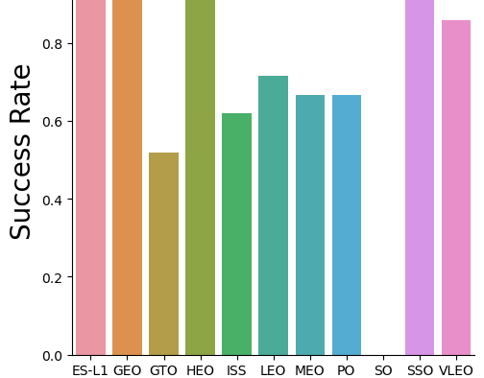
Success Rate vs. Orbit Type
Orbits with 100% success rate:
ES-L1, GEO, HEO, SSO
Orbits with 0% success rate:
SO
Orbits with success rate between 50% and 85%:
GTO, ISS, LEO, MEO, PO

Slide 22
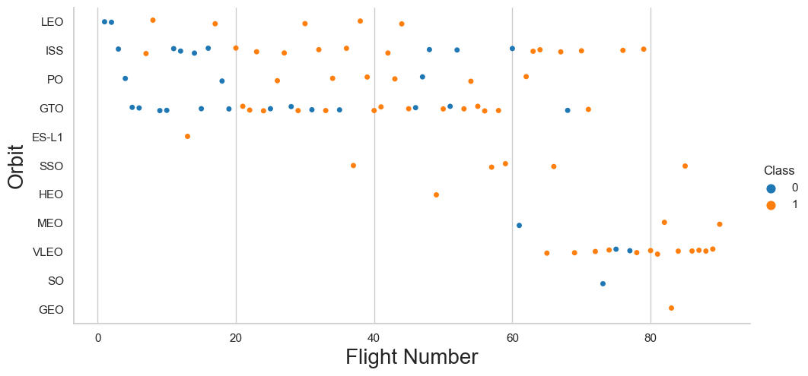
Flight Number vs. Orbit Type
Success rate improved over time to all orbits
In the LEO orbit the Success appears related to the number of flights;
There is no relationship between flight number when in GTO orbit.
increased flights to VLEO orbit .

Slide 23
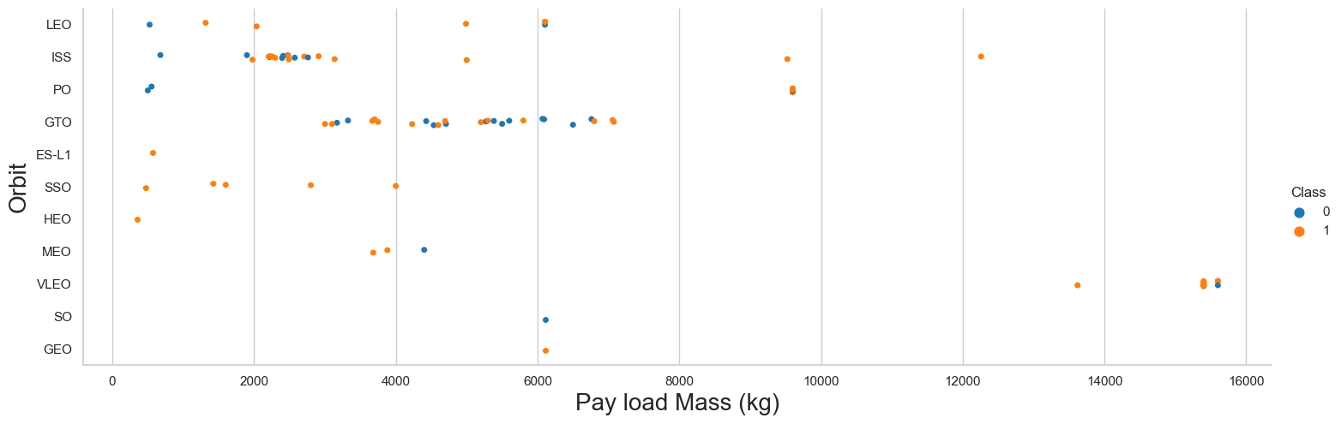
Payload vs. Orbit Type
Apparently, there is no relation between payload and success rate to orbit GTO;
ISS orbit has the widest range of payload and a good rate of success;
There are few launches to the orbits SO and GEO.

Slide 24
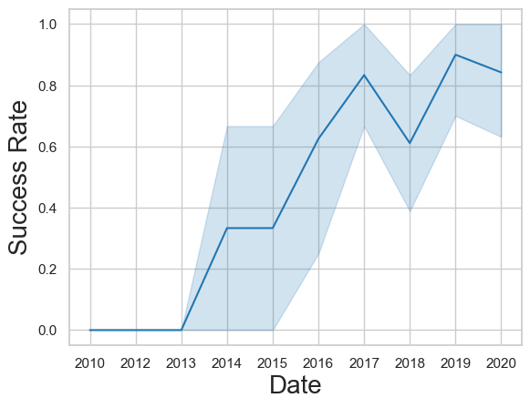
Launch Success Yearly Trend
The level of success started to rise in 2013, and 2014 was a year of stability. The growth in success continued from 2015 to 2017, possibly indicating another breakthrough. In 2017, some problems surfaced, which were addressed in 2019. In 2018, there was a decrease in success, but it was recovered and slightly improved in 2019. In 2020, there was a small decline.

Slide 25
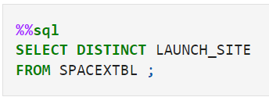
All Launch Site Names
According to data, there are four launch sites:
Launch_Site
CCAFS LC-40
VAFB SLC-4E
KSC LC-39A
CCAFS SLC-40
They are obtained by selecting unique occurrences of “ launch_site ” values from the dataset.

Slide 26
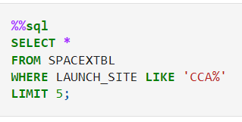
Launch Site Names Begin with 'CCA'
5 records where launch sites begin with `CCA`:
Date | Time_(UTC) | Booster_Version | Launch_Site | Payload | PAYLOAD_MASS__KG_ | Orbit | Customer | Mission_Outcome | Landing__Outcome
04-06-2010 | 18:45:00 | F9 v1.0 B0003 | CCAFS LC-40 | Dragon Spacecraft Qualification Unit | 0 | LEO | SpaceX | Success | Failure (parachute)
08-12-2010 | 15:43:00 | F9 v1.0 B0004 | CCAFS LC-40 | Dragon demo flight C1, two CubeSats, barrel of Brouere cheese | 0 | LEO (ISS) | NASA (COTS) NRO | Success | Failure (parachute)
22-05-2012 | 07:44:00 | F9 v1.0 B0005 | CCAFS LC-40 | Dragon demo flight C2 | 525 | LEO (ISS) | NASA (COTS) | Success | No attempt
08-10-2012 | 00:35:00 | F9 v1.0 B0006 | CCAFS LC-40 | SpaceX CRS-1 | 500 | LEO (ISS) | NASA (CRS) | Success | No attempt
01-03-2013 | 15:10:00 | F9 v1.0 B0007 | CCAFS LC-40 | SpaceX CRS-2 | 677 | LEO (ISS) | NASA (CRS) | Success | No attempt
Here we can see five samples of Cape Canaveral launches.

Slide 27
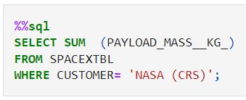
Total Payload Mass
Total payload carried by boosters from NASA equals: 45596 kg
Total payload calculated above, by summing all payloads whose codes contain ‘CRS’, which corresponds to NASA.
SUM (PAYLOAD_MASS__KG_)
45596

Slide 28
Average Payload Mass by F9 v1.1
Average payload mass carried by booster version F9 v1.1 equals:38020 kg
Filtering data by the booster version above and calculating the average
SUM (PAYLOAD_MASS__KG_)
38020

Slide 29
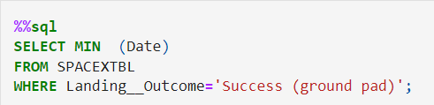
First Successful Ground Landing Date
Fist successful landing outcome on ground pad equal : 01/05/2015
By filtering data by successful landing outcome on ground pad and getting the minimum value for date it’s possible to identify the first occurrence.
MIN (Date)
01-05-2017

Slide 30
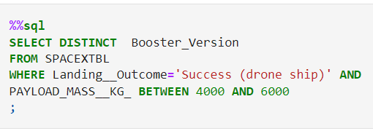
Successful Drone Ship Landing with Payload between 4000 and 6000
Boosters which have successfully landed on drone ship and had payload mass greater than 4000 but less than 6000
Selecting distinct booster versions according to the filters above, these 4 are the result.
Booster_Version
F9 FT B1022
F9 FT B1026
F9 FT B1021.2
F9 FT B1031.2

Slide 31
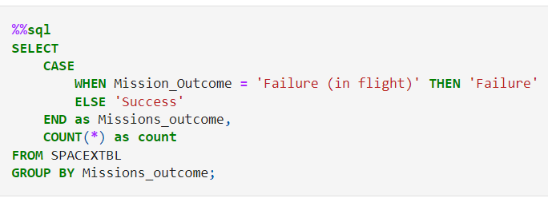
Total Number of Successful and Failure Mission Outcomes
Number of successful and failure mission outcomes:
Grouping mission outcomes and counting records for each group led us to the summary above.
Missions_outcome | count
Failure | 1
Success | 100

Slide 32
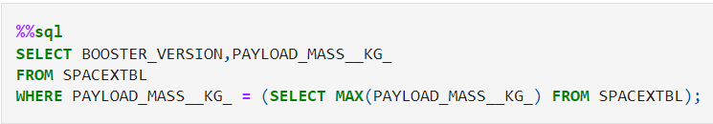
Boosters Carried Maximum Payload
Booster_Version | PAYLOAD_MASS__KG_
F9 B5 B1048.4 | 15600
F9 B5 B1049.4 | 15600
F9 B5 B1051.3 | 15600
F9 B5 B1056.4 | 15600
F9 B5 B1048.5 | 15600
F9 B5 B1051.4 | 15600
F9 B5 B1049.5 | 15600
F9 B5 B1060.2 | 15600
F9 B5 B1058.3 | 15600
F9 B5 B1051.6 | 15600
F9 B5 B1060.3 | 15600
F9 B5 B1049.7 | 15600
Boosters which have carried the maximum payload mass
These are the boosters which have carried the maximum payload mass registered in the dataset.

Slide 33
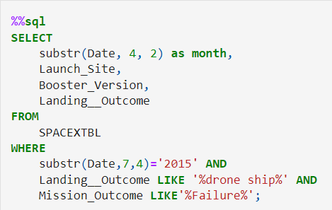
2015 Launch Records
List the records which will display the month names, failure landing_outcomes in drone ship ,booster versions, launch_site for the months in year 2015.
The list above has the only two occurrences.
month | Launch_Site | Booster_Version | Landing__Outcome
06 | CCAFS LC-40 | F9 v1.1 B1018 | Precluded (drone ship)

Slide 34
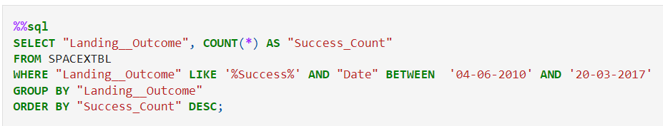
Rank Landing Outcomes Between 2010-06-04 and 2017-03-20
Rank the count of successful landing_outcomes between the date 04-06-2010 and 20-03-2017 in descending order.
Present your query result with a short explanation here
anding__Outcome | Success_Count
Success | 20
Success (drone ship) | 8
Success (ground pad) | 6

Slide 35


Slide 36

All launch sites
All launch sites are in very close proximity
to the coast, while launching rockets
towards the ocean it minimises the risk of
having any debris dropping or exploding
near people.

Slide 37
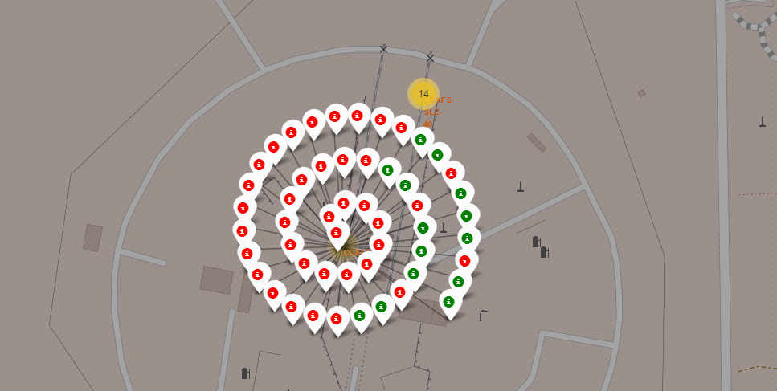
Color-labeled launch records on the map
From the color-labeled markers we should be able to easily identify which launch sites have relatively high success rates.
Green Marker = Successful Launch
Red Marker = Failed Launch

Slide 38
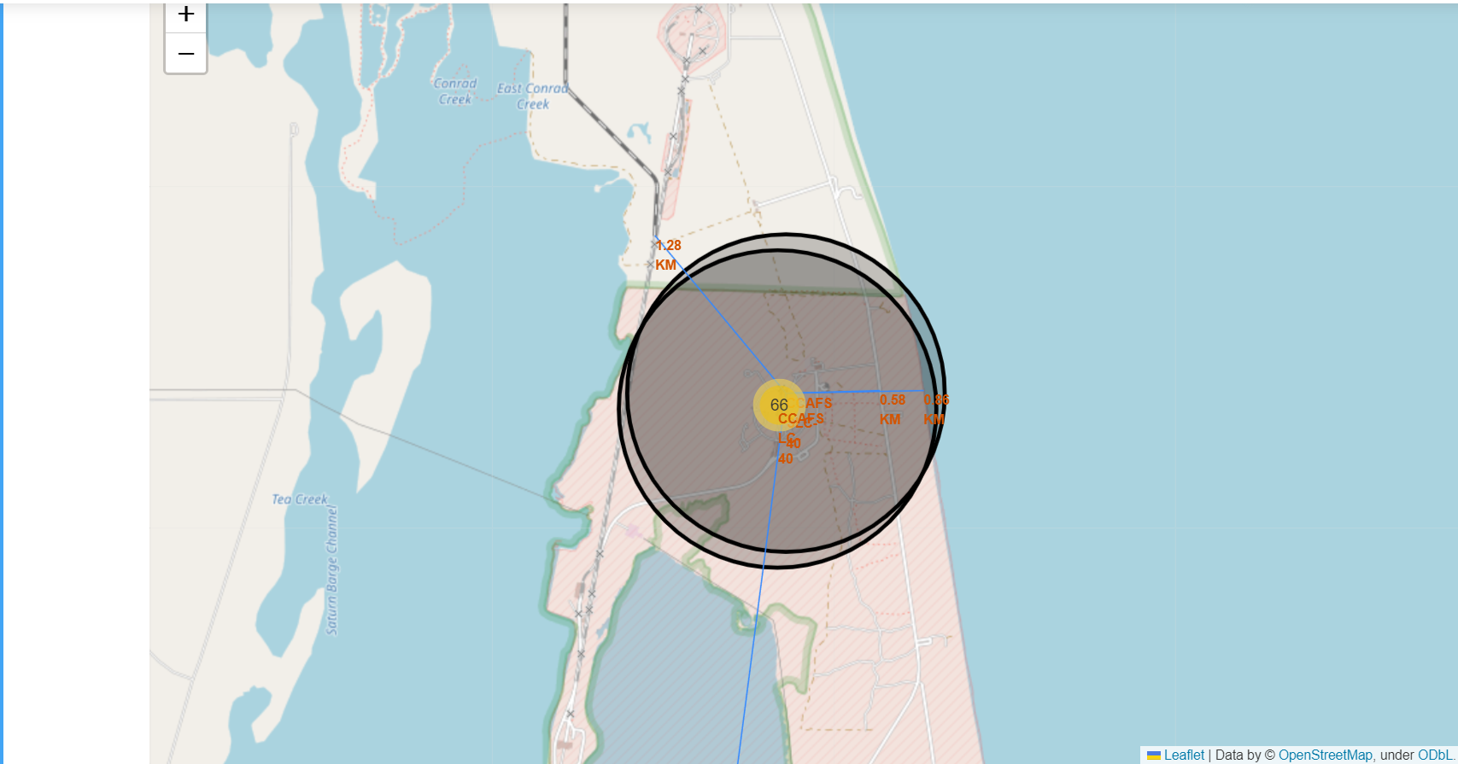
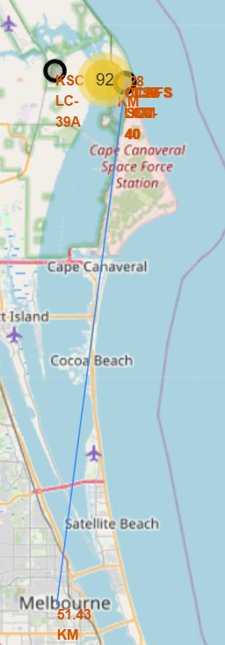
Distance from the launch site CCAFS SLC-40 to its proximities
Launch site CCAFS SLC-40 has good logistics aspects, being near railroad and road and relatively far from inhabited areas.

Slide 39
build s dashboard with plotly

Slide 40
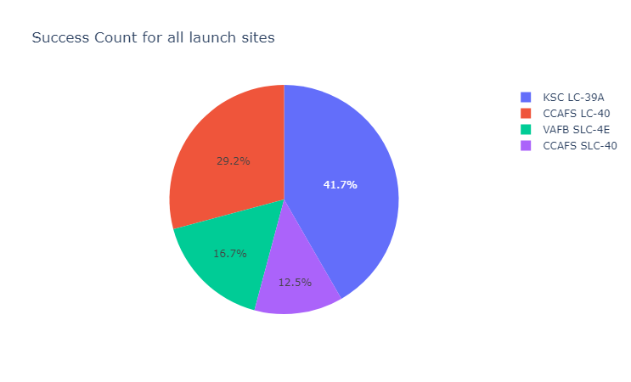
Successful Launches by Site
The place from where launches are done seems to be a very important factor of success of missions.

Slide 41
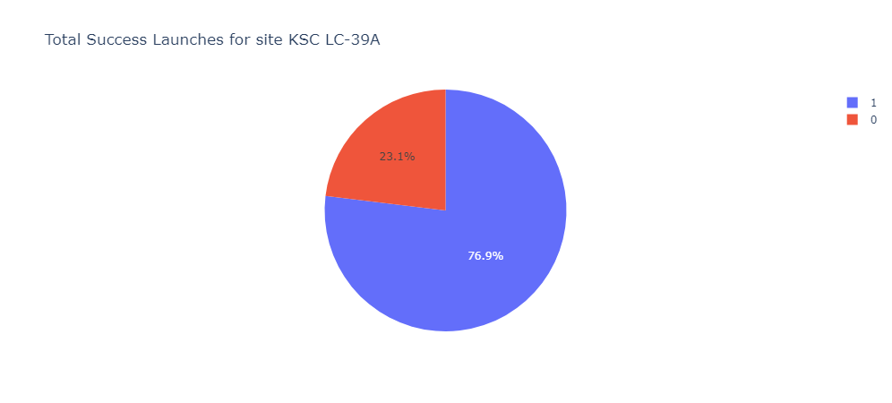
Launch Success Ratio for KSC LC-39A
76.9% of launches are successful in this site.

Slide 42
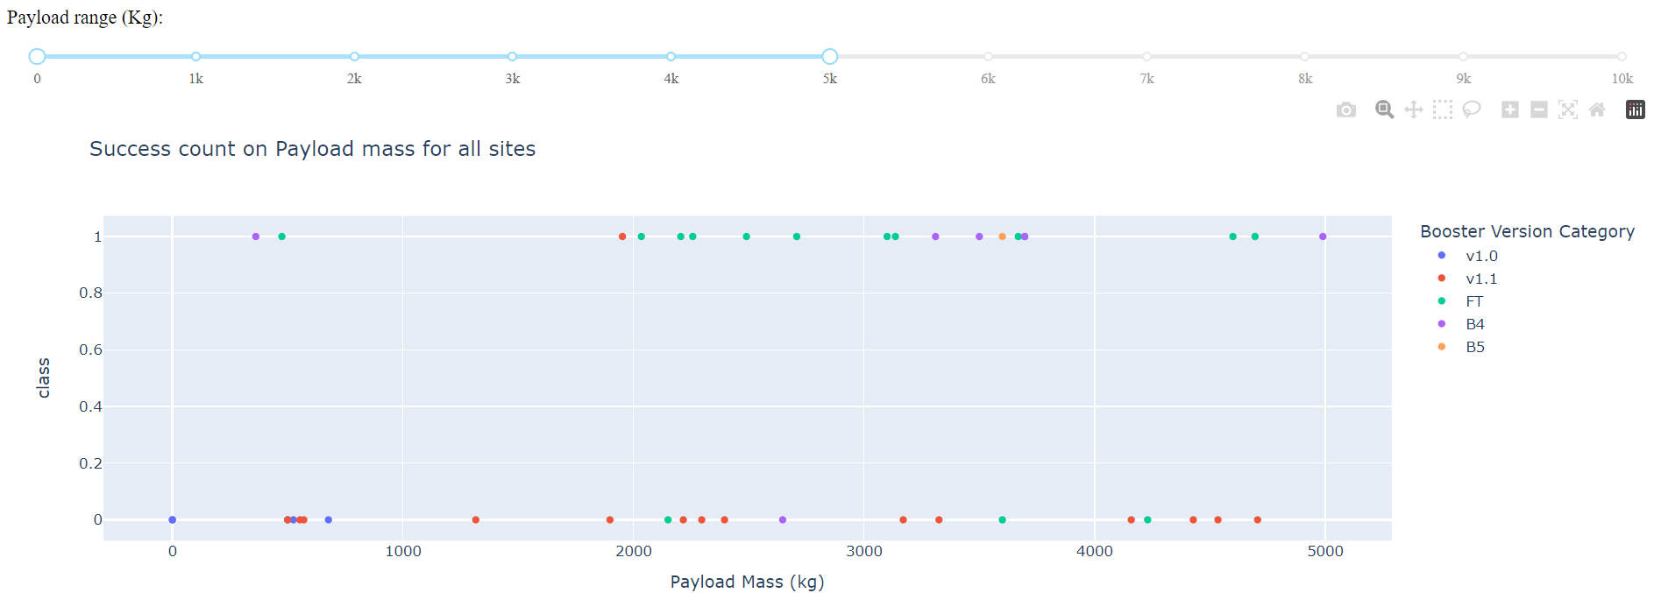
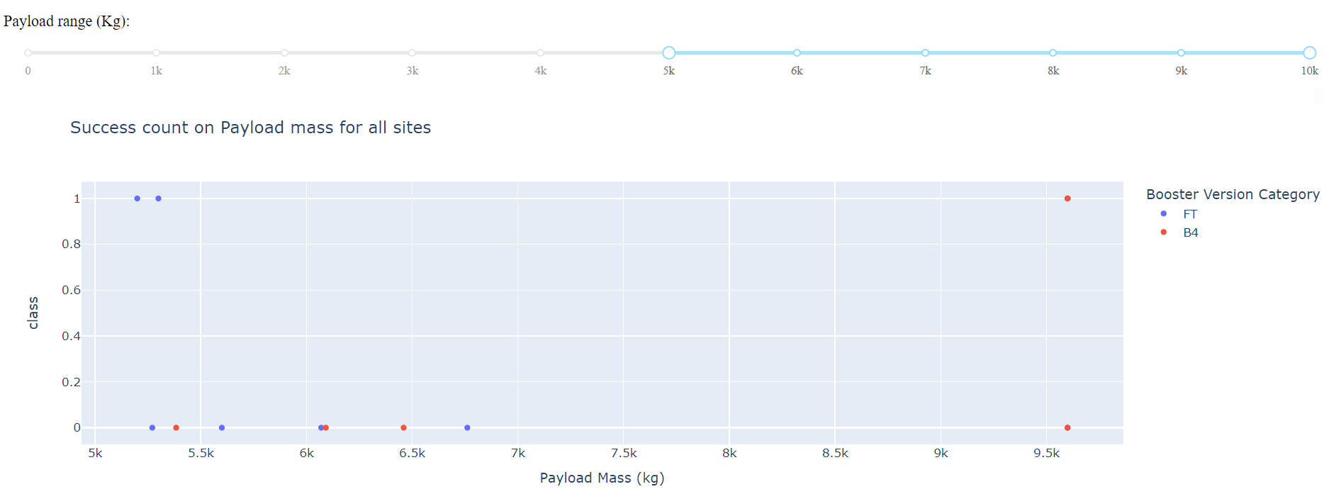
Payload Mass vs. Launch Outcome for all sites
The charts show that payloads between 2000 and 5500 kg have the highest success rate.

Slide 43

predictive analysis (classification)

Slide 44
Classification Accuracy
Based on the results of predictive analysis, it was determined that the decision tree classifier performed the poorest in predicting successful landings. On the other hand, the remaining models demonstrated comparable levels of accuracy in their predictions.
 | LogReg | SVM | Tree | KNN
Jaccard_Score | 0.800000 | 0.800000 | 0.666667 | 0.800000
F1_Score | 0.888889 | 0.888889 | 0.800000 | 0.888889
Accuracy | 0.833333 | 0.833333 | 0.722222 | 0.833333

Slide 45
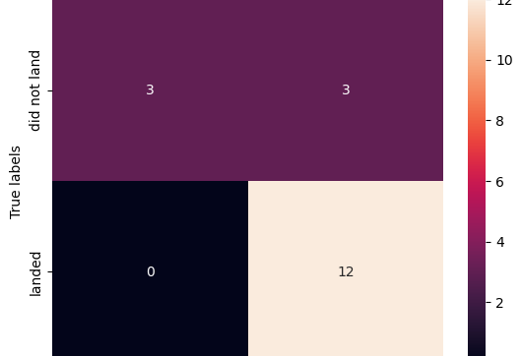
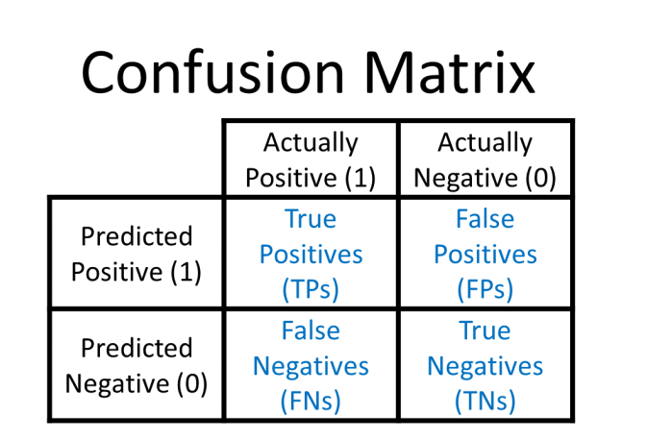
Confusion Matrix
Examining the confusion matrix, we see that logistic regression can distinguish between the different classes. We see that the major problem is false positives.

Slide 46
Conclusions
Decision Tree Model is the bad algorithm for this dataset.
Most of launch sites are in proximity to the Equator line
All the sites are in very close proximity to the coast.
The success rate of launches increases over the years.
KSC LC-39A has the highest success rate of the launches from all the sites.
•Orbits ES-L1, GEO, HEO and SSO have 100% success rate.

